Slide 1
E-commerce Cart System
Simplifying Online Shopping with Efficient Cart Management
Kunal Digdeotulwar
Nikhil Ade

Slide 2
IntroDuction
What is an E-commerce Cart System?
A core component of online shopping platforms that enables users to manage selected products before making a purchase.
It functions as a digital shopping basket, holding products that users intend to buy.
Allows for modifications such as adding, removing, or updating quantities of items.
Importance of an E-commerce Cart System:
Enhances User Experience:
Simplifies shopping by allowing users to review and manage their product selections in one place.
Provides an easy way to view the total cost of selected items, including taxes and discounts.

Slide 3
Critical for Sales Conversions:
Acts as the last step before checkout, where many customers finalize their purchases.
A well-designed cart reduces abandonment rates, leading to higher revenue.
Supports Order Organization:
Offers a clear overview of orders, ensuring that users can confirm their selections.
Key Characteristics of Modern E-commerce Cart Systems:
Real-time Updates: Reflects changes (e.g., adding/removing items) instantly.
Mobile Responsiveness: Adapts to different screen sizes for seamless shopping on any device.
Integration with Payment Systems: Ensures secure and fast transactions.
Personalization: Displays recommendations and discounts based on user behavior.

Slide 4
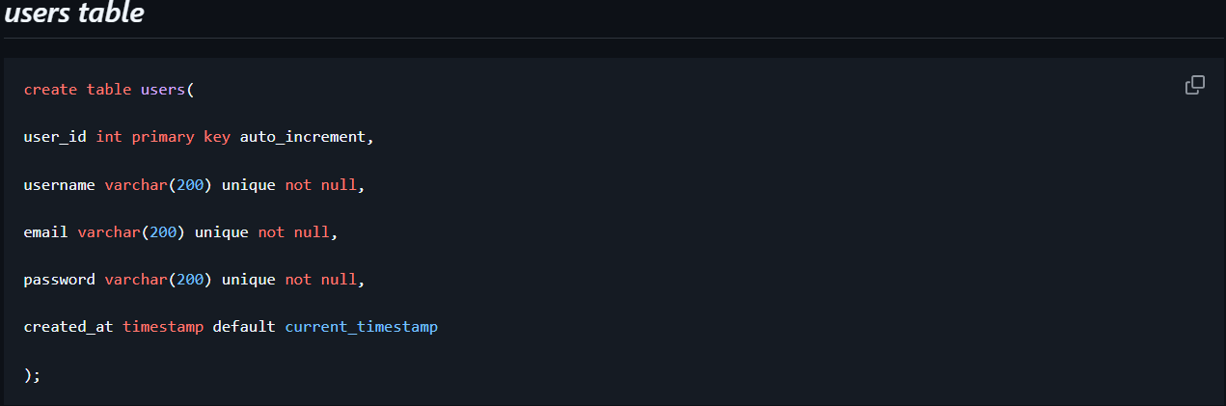
Database

Slide 5
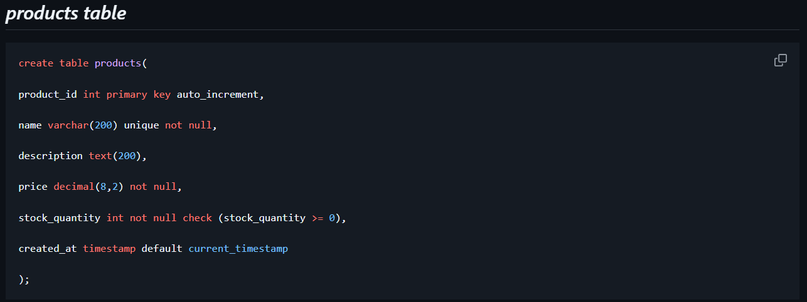
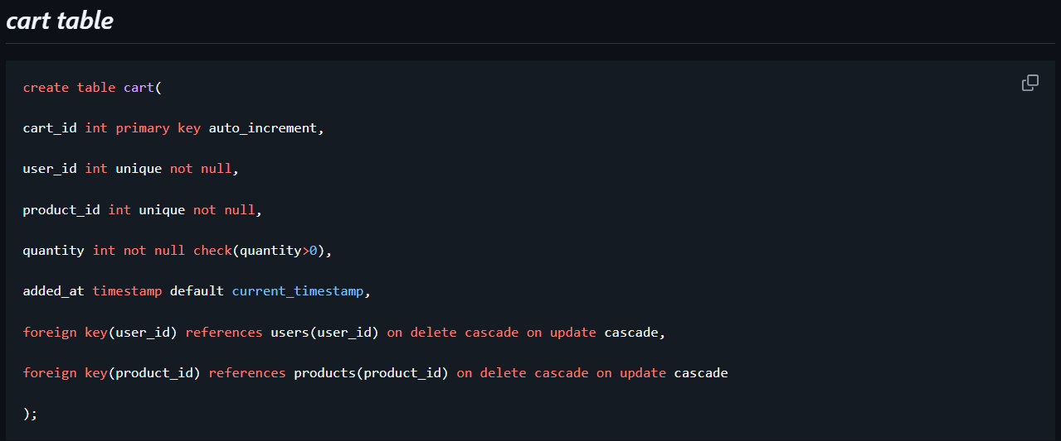

Slide 6
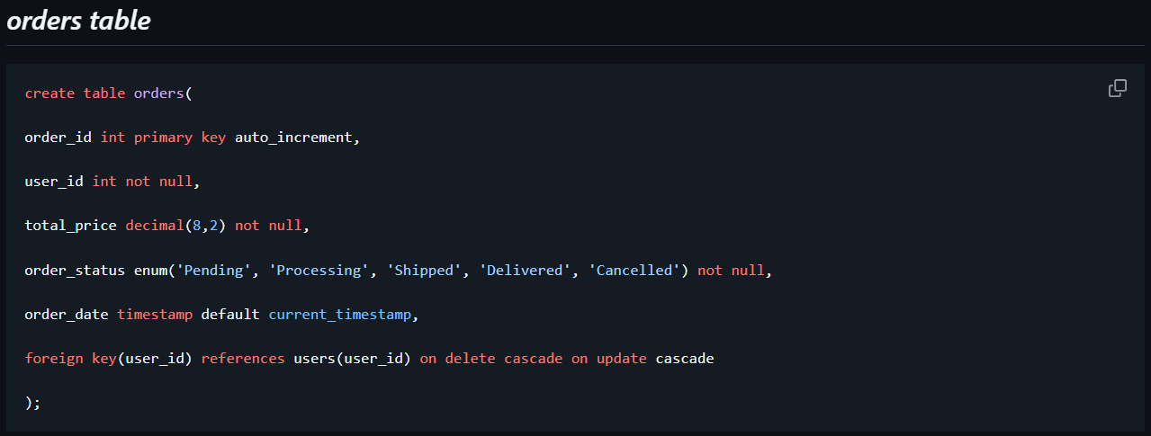
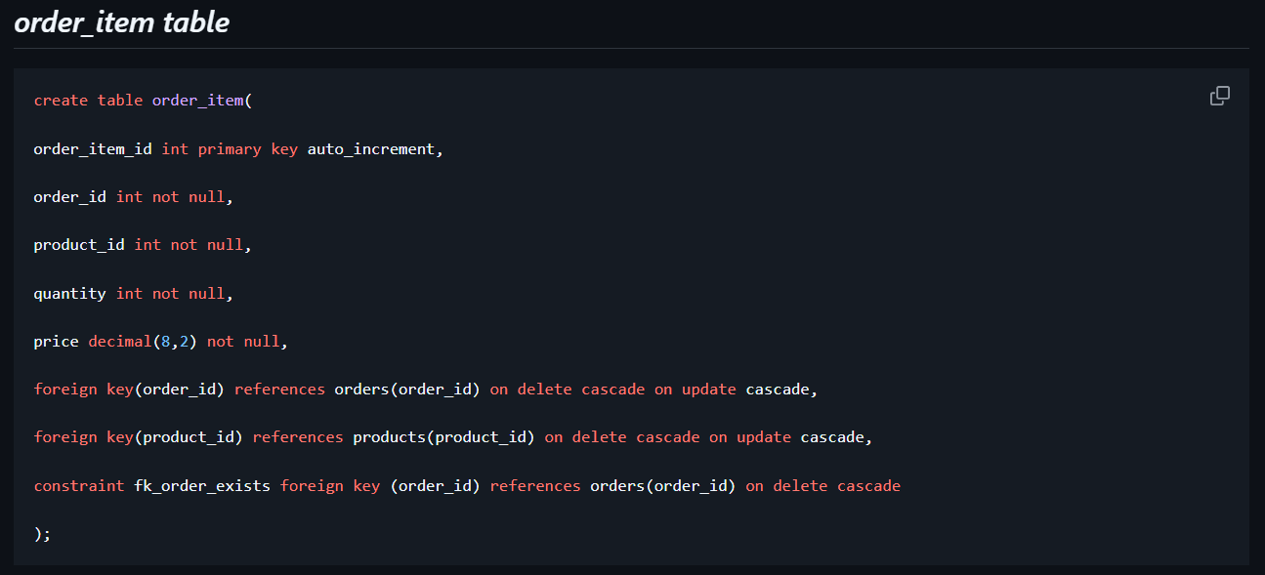

Slide 7
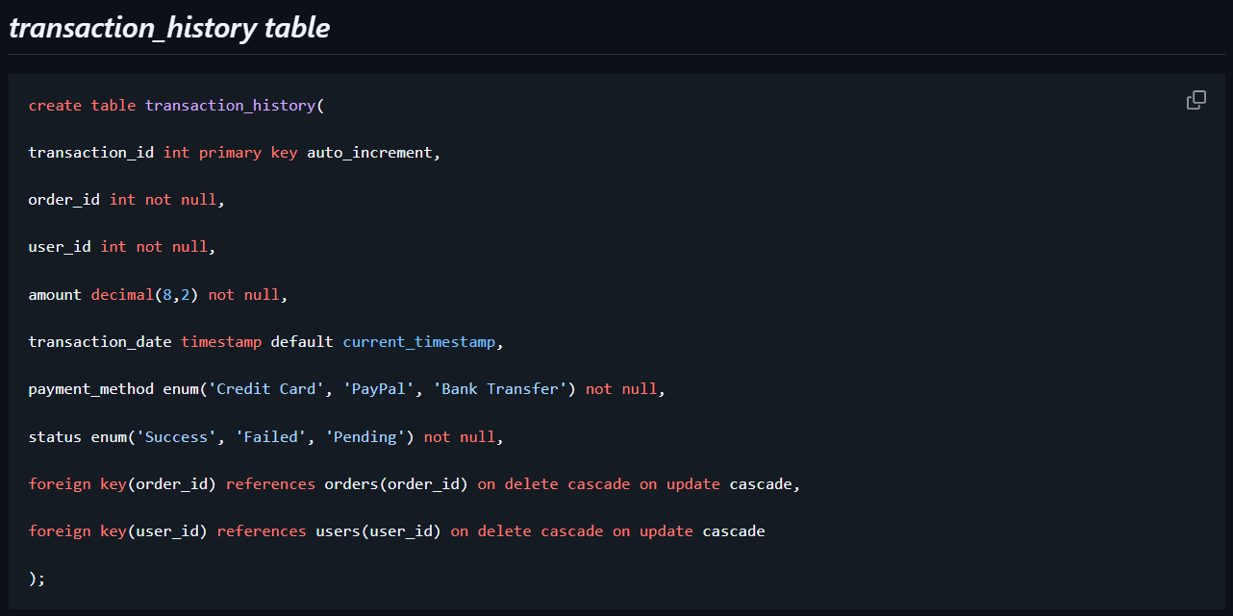

Slide 8
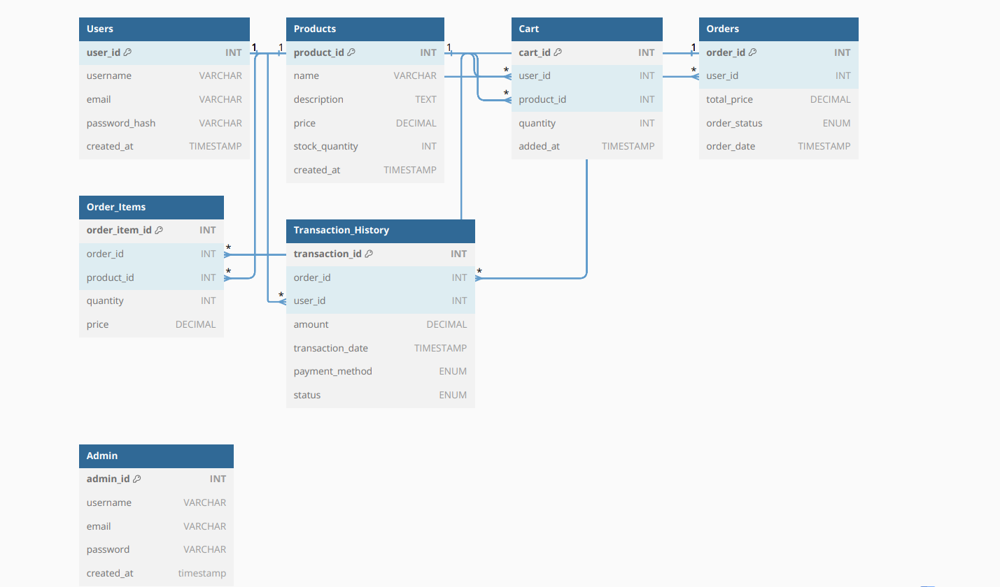
Diagram

Slide 9
Workflow
Add Products to Cart
User Action:
The user browses the product catalog and selects a product they wish to buy.
The user specifies the quantity and clicks the "Add to Cart" button.
System Action:
The system checks the Products Table to validate if sufficient stock is available.
The product details, including user_id, product_id, and quantity, are added to the Cart Table.
A confirmation message is displayed to the user: "Product successfully added to your cart."

Slide 10
View Cart
User Action:
The user can navigate to the Cart Page to review the products they have added.
System Action:
The system retrieves data from the Cart Table for the logged-in user, showing:
Product name
Quantity
Price per item
Total price for each product (calculated as price × quantity).
The grand total price is calculated and displayed dynamically.

Slide 11
Update Cart
User Action:
The user can increase, decrease, or delete products from their cart.
Options available:
Increase Quantity: Adjust product count (e.g., from 1 to 2).
Decrease Quantity: Reduce product count.
Remove Product: Remove a specific product entirely from the cart.
System Action:
When the user updates the cart:
The system validates stock availability for quantity changes.
Updates the Cart Table to reflect the new quantity or product removal.
Recalculates the total price for each product and the grand total.
Displays a confirmation message like "Cart updated successfully."

Slide 12
Validate Stock Availability
System Action:
Before checkout, the system checks the Products Table to ensure the stock quantity meets the cart's requirements.
If stock is insufficient:
A message is shown: "Sorry, the selected quantity exceeds available stock.“
The user must adjust the quantity accordingly.
Proceed to Checkout
User Action:
Once satisfied with the cart, the user clicks "Proceed to Checkout".
System Action:
The system prepares order details by summarizing the products, quantities, and total price.
The cart data is temporarily stored to create an order in the Orders Table.
The system redirects the user to the Payment Page to finalize the purchase.

Slide 13
Admin Role
Who is the Admin? The admin is a superuser responsible for managing and overseeing the entire e-commerce platform.
Primary Objective:
Maintain the integrity and functionality of the system.

Slide 14
Key Responsibilities of Admin
Product Management
Add, update, or delete products in the inventory.
Manage product categories and descriptions.
Order Management
View all placed orders.
Update the status of orders (e.g., pending, shipped, delivered).

Slide 15
Inventory Management
Monitor stock levels.
Update stock quantities for products.

Slide 16
Library used
Lombok :
Lombok is a popular Java library that helps developers reduce boilerplate code, particularly in object-oriented programming. By using Lombok annotations, you can automatically generate common code elements such as getters, setters, constructors, and more during compilation. This simplifies code maintenance and improves readability.

Slide 17
Log4j :
Log4j (short for "Logging for Java") is a popular, open-source logging framework for Java-based applications. It is part of the Apache Logging Services project and provides developers with the ability to log application messages for debugging, monitoring, and auditing purposes.

